Slide 1

xMicrosoft Recommenders
Using Jupyter notebooks, Python and the https://www.github.com/Microsoft/Recommenders repo, I'll demonstrate how you can make your own Recommendation system using AzureML. I'll note the benefits of Azure ML and its ability to use all of the usual Python tools and libraries that are popular today. In addition, various models used for recommendation systems will be compared using predictions developed on the MovieLens dataset.
https://github.com/Microsoft/Recommenders
Notes:
Discuss NOT going deep into algorithms. Details of that are on the website

Slide 2
Learn to make your own Recommendation System with AzureML
Beth Zeranski
Principal Experimentation Engineer
http://github.com/bethz/2019GlobalAzureBootcamp
https://github.com/Microsoft/Recommenders
https://twitter.com/bethzeranski
Linkedin: aka.ms/bethz
April 27, 2019

Slide 3
Agenda
Goal
Why Recommendation Systems?
What is a Recommendation System?
Powerpoint’s AWESOME Recommendation System
http://github.com/Microsoft/Recommenders
Solution Architecture
Data – public movielens data
Walk through Repo
Azure Machine Learning, AzureML
Workflow for SAR, Smart Adaptive Recommendation solution
https://github.com/Microsoft/Product-Recommendations/blob/master/doc/sar.md
Code Walk through

Slide 4
Goal
Provide sufficient context and guidance so you can use the Recommenders github repo to make your own Recommendation System
Highlight notebooks demonstrate multiple algorithms, automated parameter tuning and even algorithm selection to assist.

Slide 5
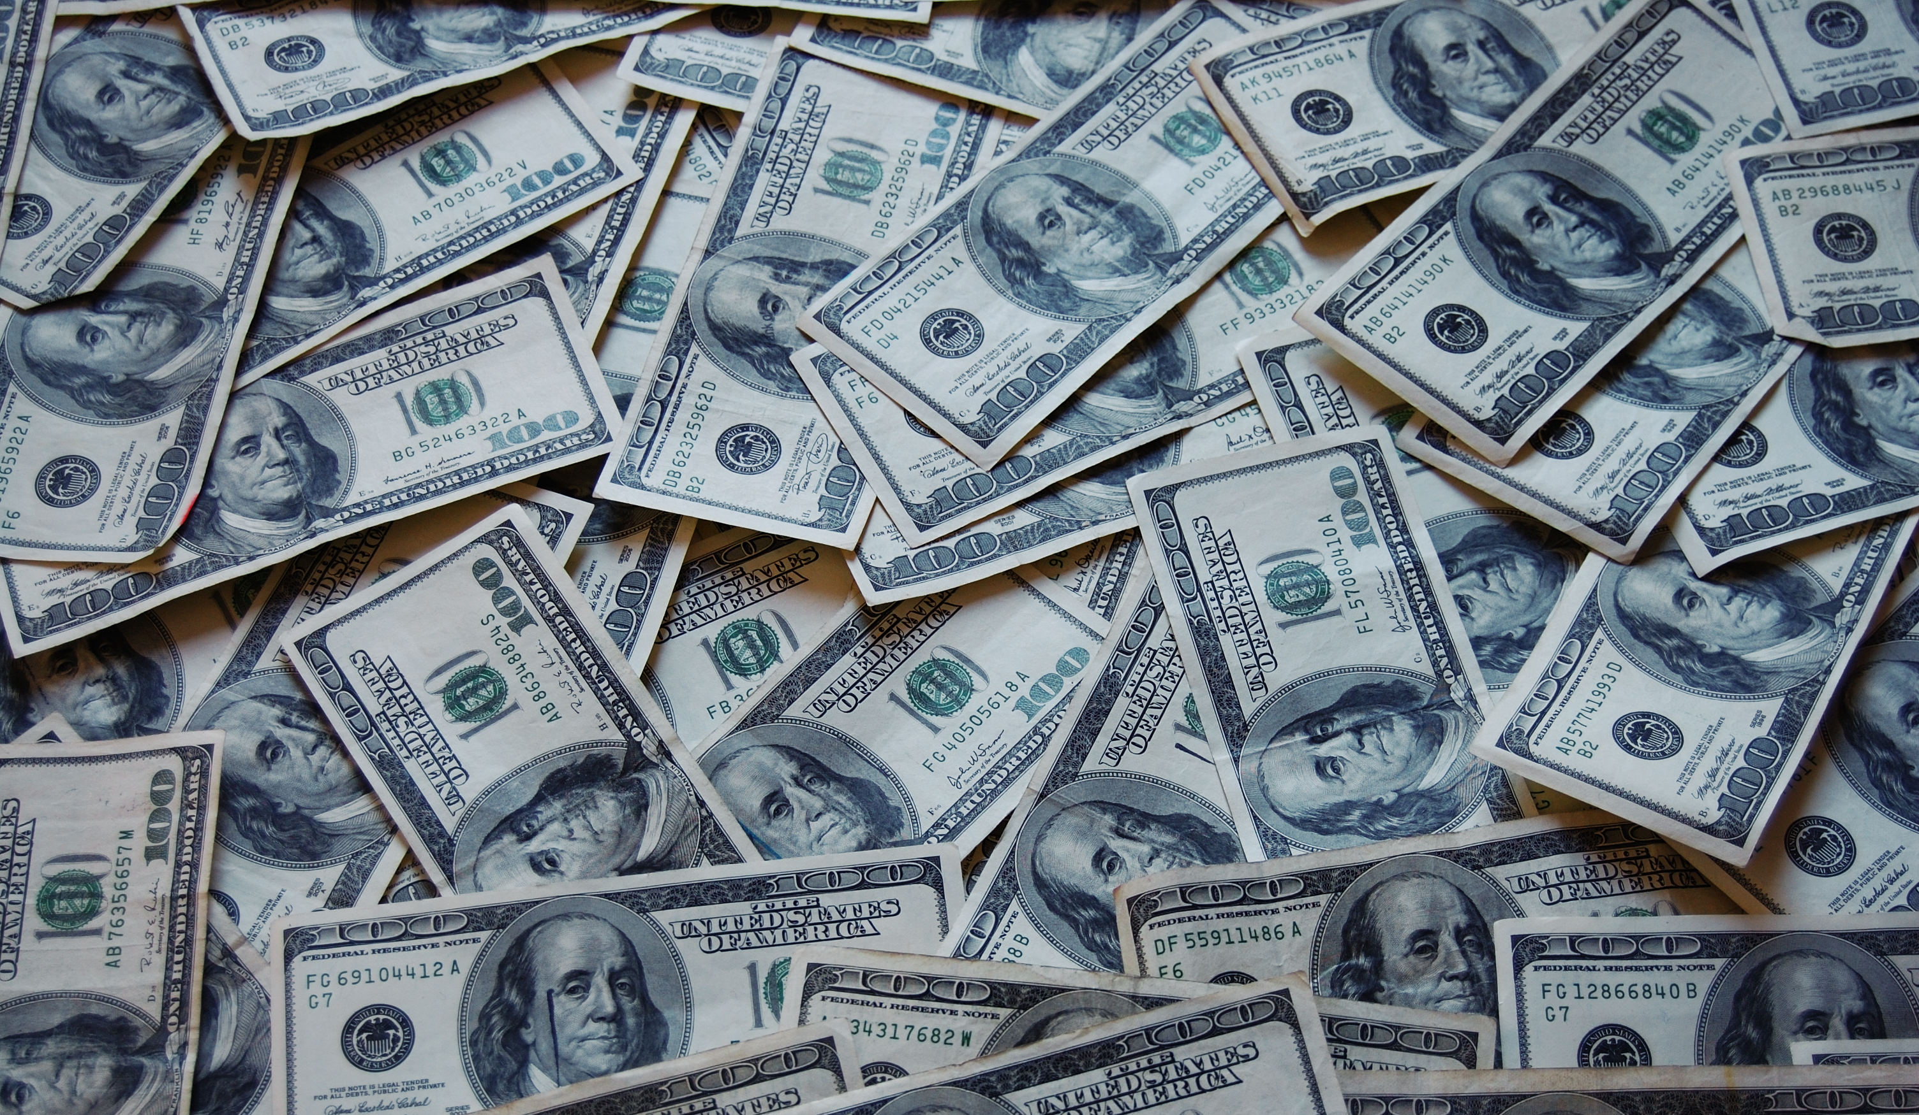
Why Recommendation Systems?
Huge Revenue Impact!
https://github.com/Microsoft/Recommenders

Slide 6

“35% of what consumers purchase on Amazon and 75% of what they watch on Netflix come from recommendations algorithms”
McKinsey & Co

Slide 7
What is a Recommendation System?
…is a subclass of information filtering systems that seek to predict the ‘rating’ or ‘preference’ that a user would give to an item
https://en.wikipedia.org/wiki/Recommender_system
Notes:
Recommendations are based on what user likes, or others like the user have liked or may even have been requested by user
A useful recommendation is about understanding the data and the users
Discussion: Is it more important to have super good algorithm or more data?
Could be for purchases, connections on Linkedin, Movies on Netflix, medical recommendations and more.

Slide 8
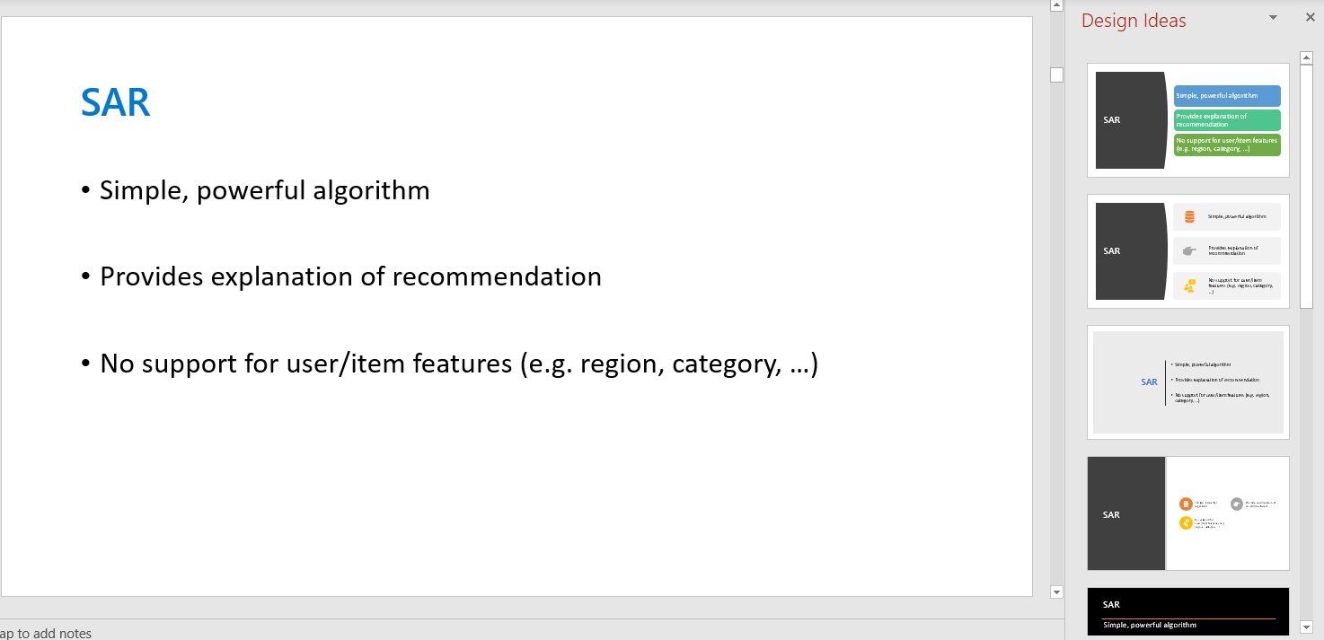
Powerpoint has an AWESOME Recommendation System
My simple slide
Design Ideas
Powerpoint’s “Design Ideas” Recommendation system created a number of improved layouts which are more compelling for my slides
Fast and Easy

Slide 9
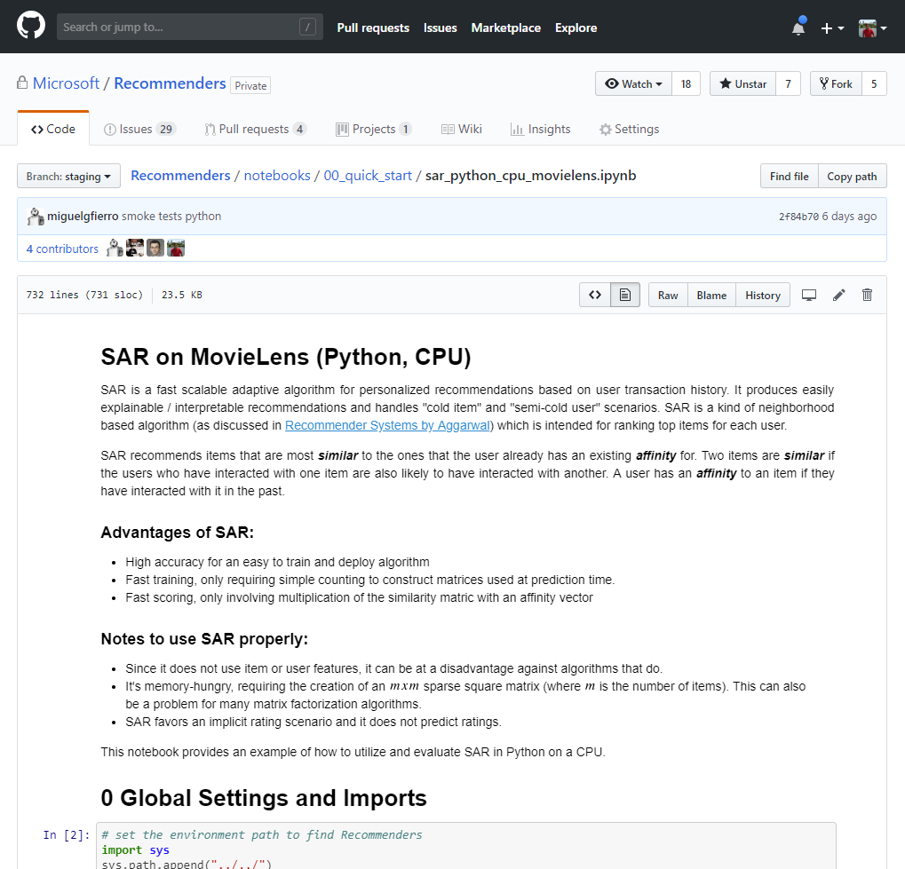
Key Themes of our Recommenders repo
Reduce time and effort required for Proof of Concept
Lower barrier of entry for implementation
Easily scale out on Azure
Widely usable and open-source
Provide advanced algorithms
https://github.com/Microsoft/Recommenders

Slide 10
Microsoft/Recommenders
Microsoft/Recommenders
Collaborative development efforts of Microsoft Cloud & AI data scientists, Microsoft Research researchers, academia researchers, etc.
Github url: https://github.com/Microsoft/Recommenders
Contents
Utilities: modular functions for model creation, data manipulation, evaluation, etc.
Algorithms: SVD, SAR, ALS, NCF, Wide&Deep, xDeepFM, DKN, etc.
Notebooks: HOW-TO examples for end to end recommender building.
Highlights
2800+ stars on GitHub
Featured in YC Hacker News, O’Reily Data Newsletter, GitHub weekly trending list, etc.
Any contribution to the repo will be highly appreciated!
Create issue/PR directly in the GitHub repo
Send email to RecoDevTeam@service.microsoft.com for any collaboration

Slide 11
Recommenders Architecture

Slide 12
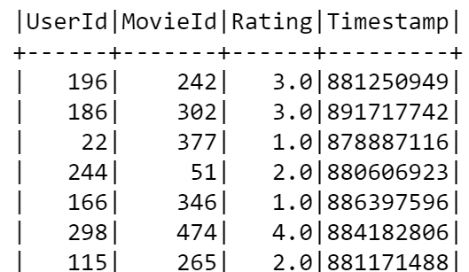
Data format
User ID
Item ID
Time (Optional)
Event Weight (Optional)
Rating
Number of item views
Number of purchases

Slide 13
Repository General Components
Reco Utilities
Notebooks
Tests
Dataset helpers
Splitters
Ranking Metrics
Rating Metrics
Diversity Metrics
Spark ALS
SAR: Spark and Python implementation
Deep Learning algos from MSR (DeepRec)
Open source frameworks: Surprise
Unit tests
Integration tests
Nightly builds
Benchmarks updated every night

Slide 14
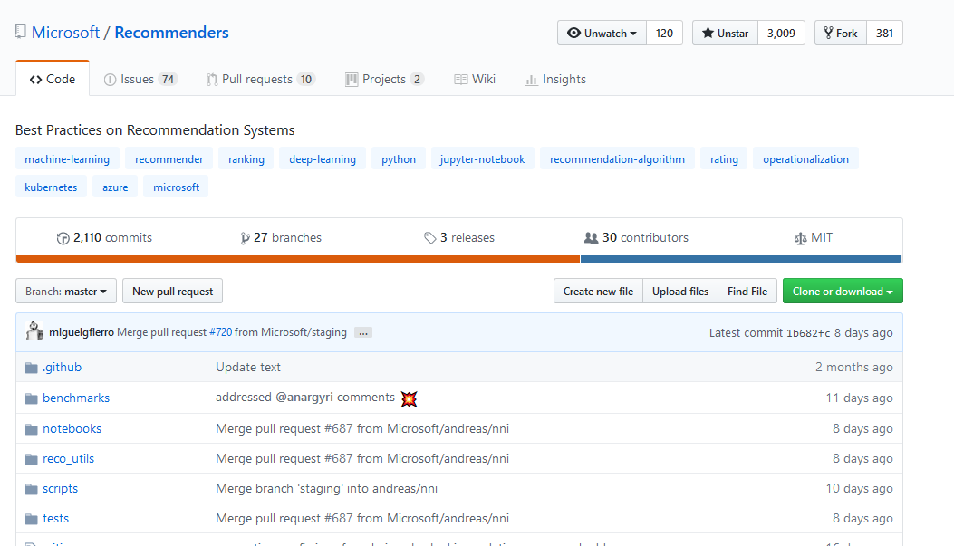
Repository Walk-thru
https://github.com/Microsoft/Recommenders

Slide 15
Why Azure ML Service?
Training in the cloud
Highly scalable and flexible model training
Rapid Iteration
Model Traceability
Automated Data, Output, Notebook and related Asset Retention
Azure ML’s automated machine learning finds algorithms based on your data
Pipelines for repeatability and sharing

Slide 16
Workspace
The workspace is the top-level resource for Azure Machine Learning service. It provides a centralized place to work with all the artifacts you create when you use Azure Machine Learning service.
The workspace keeps a list of compute targets that you can use to train your model. It also keeps a history of the training runs, including logs, metrics, output, and a snapshot of your scripts. You use this information to determine which training run produces the best model.
You register models with the workspace. You use a registered model and scoring scripts to create an image. You can then deploy the image to Azure Container Instances, Azure Kubernetes Service, or to a field-programmable gate array (FPGA) as a REST-based HTTP endpoint. You can also deploy the image to an Azure IoT Edge device as a module.
You can create multiple workspaces, and each workspace can be shared by multiple people.
Workspace is accessible in portal.azure.com or by Command Line Interface
For more info:
https://docs.microsoft.com/en-us/azure/machine-learning/service/concept-azure-machine-learning-architecture

Slide 17
Experiment
An experiment is a grouping of many runs from a specified script. It always belongs to a workspace. When you submit a run, you provide an experiment name. Information for the run is stored under that experiment. If you submit a run and specify an experiment name that doesn't exist, a new experiment with that newly specified name is automatically created.
For an example of using an experiment, see Quickstart: Get started with Azure Machine Learning service.

Slide 18
Model
At its simplest, a model is a piece of code that takes an input and produces output. Creating a machine learning model involves selecting an algorithm, providing it with data, and tuning hyperparameters. Training is an iterative process that produces a trained model, which encapsulates what the model learned during the training process.
A model is produced by a run in Azure Machine Learning. You can also use a model that's trained outside of Azure Machine Learning. You can register a model in an Azure Machine Learning service workspace.
Azure Machine Learning service is framework agnostic. When you create a model, you can use any popular machine learning framework, such as Scikit-learn, XGBoost, PyTorch, TensorFlow, and Chainer.
For an example of training a model, see Tutorial: Train an image classification model with Azure Machine Learning service.

Slide 19
Model registry
The model registry keeps track of all the models in your Azure Machine Learning service workspace.
Models are identified by name and version. Each time you register a model with the same name as an existing one, the registry assumes that it's a new version. The version is incremented, and the new model is registered under the same name.
When you register the model, you can provide additional metadata tags and then use the tags when you search for models.
You can't delete models that are being used by an image.
For an example of registering a model, see Train an image classification model with Azure Machine Learning.

Slide 20
Run Configuration
An environment defined for each compute target so that you can run your training scripts on different compute targets without modification.
For example, to use a local target configuration:
from azureml.core import ScriptRunConfig
import os
script_folder = os.getcwd()
src = ScriptRunConfig(source_directory = script_folder, script = 'train.py', run_config = run_local)
run = exp.submit(src)
run.wait_for_completion(show_output = True)
Switch the same experiment to run in a different compute target by using a different run configuration, such as the AzureML Compute target:
from azureml.core import ScriptRunConfig
src = ScriptRunConfig(source_directory = script_folder, script = 'train.py', run_config = run_amlcompute)
run = exp.submit(src)
run.wait_for_completion(show_output = True)

Slide 21
Command Line Interface
Attach a run configuration before submitting an experiment
az ml project attach --experiment-name myhistory
Start a run of your experiment. The compute target uses the run configuration to create the training environment for the model.
az ml run submit -c myrunconfig train.py
View list of submitted experiments
az ml history list
Notes:
Start a run of your experiment. When using this command, specify the name of the runconfig file that contains the run configuration. The compute target uses the run configuration to create the training environment for the model. In this example, the run configuration is loaded from the file.

Slide 22
During local training or cloud training, have you ever lost a run?
Days or weeks go by and models+info go missing
Azure ML service enables you to log artifacts from local experimentation or cloud training painlessly to the cloud. That includes inputs, notebooks, outputs and more!
That means the work is easily repeatable (and findable) by you or anyone with access

Slide 23
Other info
Exporting and deleting data
https://docs.microsoft.com/en-us/azure/machine-learning/service/how-to-export-delete-data
Start, monitor and cancel training runs
https://docs.microsoft.com/en-us/azure/machine-learning/service/how-to-manage-runs
Log Metrics
https://docs.microsoft.com/en-us/azure/machine-learning/service/how-to-track-experiments
Estimator – convenient object that wraps run configuration information to specify how a script is executed for model training
https://github.com/Azure/MachineLearningNotebooks/blob/master/how-to-use-azureml/training-with-deep-learning/how-to-use-estimator/how-to-use-estimator.ipynb

Slide 24
Workflow
The machine learning workflow generally follows this sequence:
Develop machine learning training scripts in Python.
Create and configure a compute target.
Attach the compute target to your workspace.
Configure the compute target so it contains the Python environment and package dependencies required.
Submit the scripts to the configured compute target to run in that environment. During training, the scripts can read from or write to datastore. The records of execution are saved as runs in the workspace and grouped under experiments.
Query the experiment for logged metrics from the current and past runs. If the metrics don't indicate a desired outcome, loop back to step 1 and iterate on your scripts. All artifacts are stored together for revisiting prior work and outcomes.
After a satisfactory run is identified, register the persisted model in the model registry.
Develop a scoring script.
Create an image and register it in the image registry.
Deploy the image as a web service in Azure.

Slide 25
Start Here
https://github.com/Azure/MachineLearningNotebooks/blob/master/configuration.ipynb

Slide 26
Demo: SAR Quickstart https://github.com/Microsoft/Recommenders/blob/master/notebooks/00_quick_start/sar_movielens_with_azureml.ipynb https://github.com/Microsoft/Recommenders/blob/master/notebooks/run_notebook_on_azureml.ipynb https://github.com/Microsoft/Recommenders/blob/master/notebooks/00_quick_start/sar_movielens.ipynb
Notes:
First, look at SAR
Then, look at run_notebook_on_azureml
Finally, sar with Azure ML

Slide 27
References Great detail on Algorithm and deeper dive on creating a system www.github.com/yueguoguo/pakdd2019tutorial Train an image classification model with AzureML https://github.com/Azure/MachineLearningNotebooks/blob/master/tutorials/img-classification-part1-training.ipynb Deploy an image classification model in Azure Container Instance https://github.com/Azure/MachineLearningNotebooks/blob/master/tutorials/img-classification-part2-deploy.ipynb Textbook: Recommender Systems: The Textbook by Charu C. Aggarwal https://www.amazon.com/Recommender-Systems-Textbook-Charu-Aggarwal/dp/3319296574 Blog: https://azure.microsoft.com/en-us/blog/experimentation-using-azure-machine-learning/

Slide 28
Questions?
Microsoft Recommenders
https://github.com/Microsoft/Recommenders

Slide 29
Example of an end-to-end pipeline
User profile
Content based recommender
Collaborative filtering typed recommender
Item feature
User-item interactions
Dataset
Recommender
Evaluator
Chronological split
Stratified split
Non-overlap split
Random split
Rating evaluation metrics
Ranking evaluation metrics
Distribution evaluation metrics

Slide 30





SAR
User History
Similarity Matrix (Sparse)
Recommendation
2
0.8
1.6
0.1
1.1
0.9
1
0.2
0.2
Purchased
Score

Slide 31
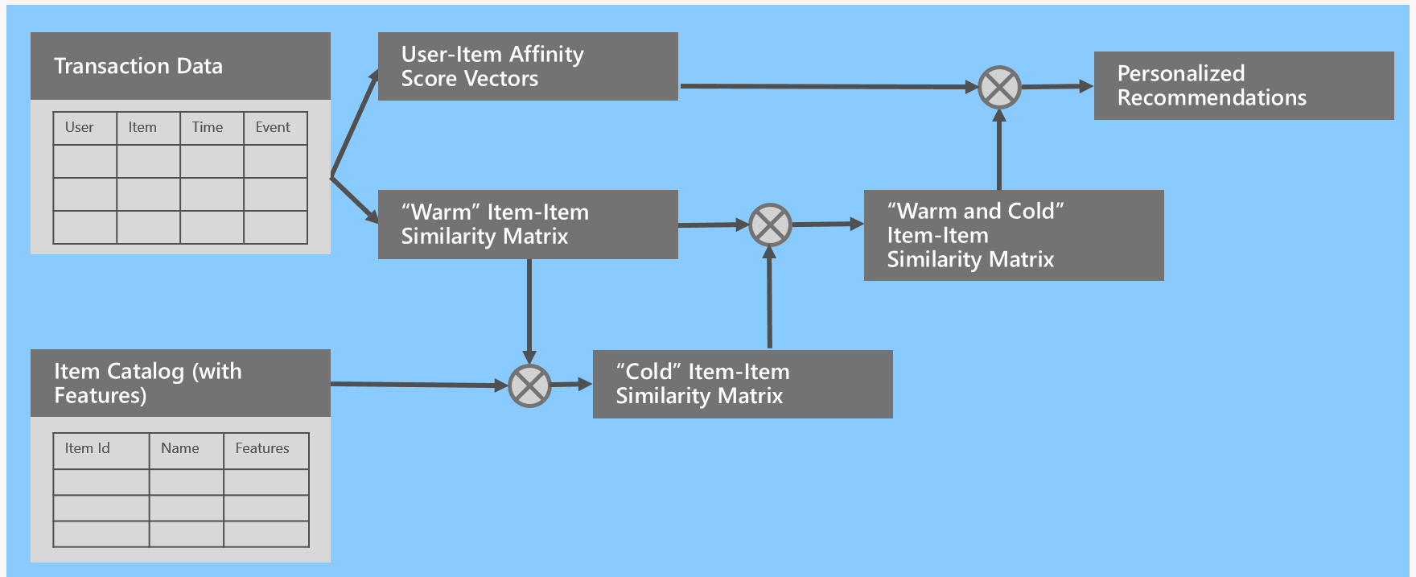
SAR overview

Slide 32
Data Splitting
Stratified splitting
e.g. movie ratings
Avoid cold-users
Train users = test users
Chronological splitting
e.g. fashion items, news, …
User taste changes over time
Obey time-dependency

Slide 33
SAR
Simple, powerful algorithm
Provides explanation of recommendation
No support for user/item features (e.g. region, category, …)

